Slide 1
NAGP
Ecommerce Case Study
“NAGP 2024-25”
Akshat Aggarwal

Slide 2




01
Understanding of Problem / Use-case
Table of contents
02
Design Considerations (NFR’s)
03
Artifacts (UML Diagram)
04
Solution Overview and Solution Diagram
05
High Level Architecture Diagram
06
Technology Stack
07
Deployment Diagram
08
Assumptions

Slide 3
Understanding of Problem/ Use-Cases

Slide 4
Problem Understanding / Use-Cases
Seamless Product Exploration
Users can browse a diverse range of products across multiple categories (e.g., Men, Women, etc.).
Search feature helps users quickly find their desired products.
2. Flexible User Authentication
New users can register using basic details and email verification.
Third-party login options (e.g., GitHub) provide a hassle-free sign-in experience.
3. Effortless Shopping Experience
Users can select products, add them to the cart, and view their selected items on the Cart Page.
If not logged in, they will be prompted to sign in before checkout.
4. Smooth Checkout & Secure Payments
Users can enter delivery details and choose from multiple payment options.
Orders are placed seamlessly, ensuring a secure and efficient transaction process.

Slide 5
Design Considerations (NFR’s)

Slide 6

NFR’s Considered for the Application
Performance & Scalability 🚀
Optimized database queries & indexing for fast response times.
Auto-scaling with AWS ECS to handle traffic surges.
Availability & Reliability ⚡
Maximum uptime using multi-AZ deployment.
Database read replicas.
Load balancer for failover & redundancy.
Security 🔒
JWT-based authentication with OAuth 2.0.
WAF & Shield for enhanced security and access control.
Maintainability 🔄
Microservices-based architecture for easy updates.
Version control with CI/CD pipelines.

Slide 7
Continuing….
5. Monitoring & Logging 📊
AWS CloudWatch, CloudTrail, and X-Ray for real-time monitoring.
6. Data Integrity 📜
ACID-compliant SQL database for transactions.
Event-driven architecture for data consistency.
7. Compatibility 🖥️
Supports major browsers (Chrome, Firefox, Edge, Safari).
Works on desktop, mobile, and tablets.

Slide 8
Artifacts (UML Diagram)

Slide 9
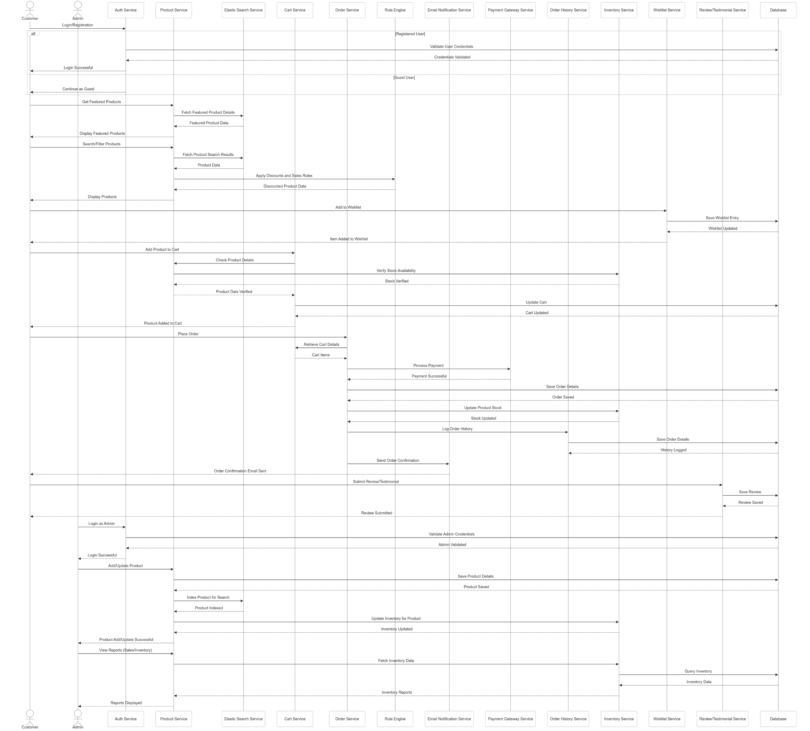
UML Diagram (Sequential Diagram)

Slide 10
Solution Overview and Solution Diagram

Slide 11
Solution Overview
Frontend
Dynamic and responsive UI with a smooth user experience using React.
Responsive Product Listing and filtering based on different filters.
Secure Authentication leveraging OAuth (GitHub) and traditional username-password mechanisms.
Backend – Microservices
Product, Cart, Order, Inventory, Wishlist, Review, Search Service etc.
Drool’s Rule Engine for managing dynamic pricing and discounts.
Kafka-based event-driven architecture for smooth inter-service communication.
Database & Storage
MySQL for structured data like orders & user details.
Mongo DB - NoSQL for products data, carts and reviews.
Redis Cache for faster response times.
S3 Bucket for storing images and static content.

Slide 12
Continuing.…
AWS-based Deployment
AWS ECS with Fargate for deploying and scaling containerized microservices without server management.
API Gateway with authentication & rate limiting.
CloudFront CDN for faster content delivery.
AWS SNS & SES for email & push notifications.
Observability & Security
CloudWatch, CloudTrail & AWS X-Ray for monitoring and debugging.
WAF & Shield for enhanced security and access control.
Automated Backups & Disaster Recovery for business continuity.

Slide 13
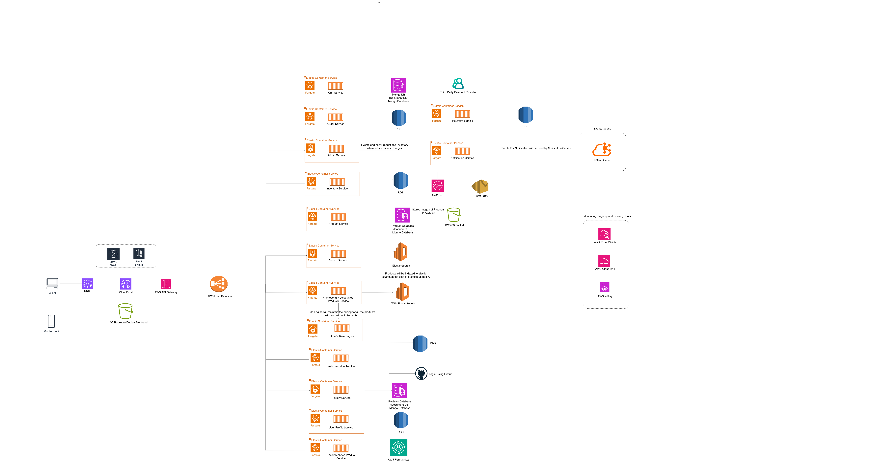
Solution Diagram

Slide 14
High Level Architecture Diagram

Slide 15
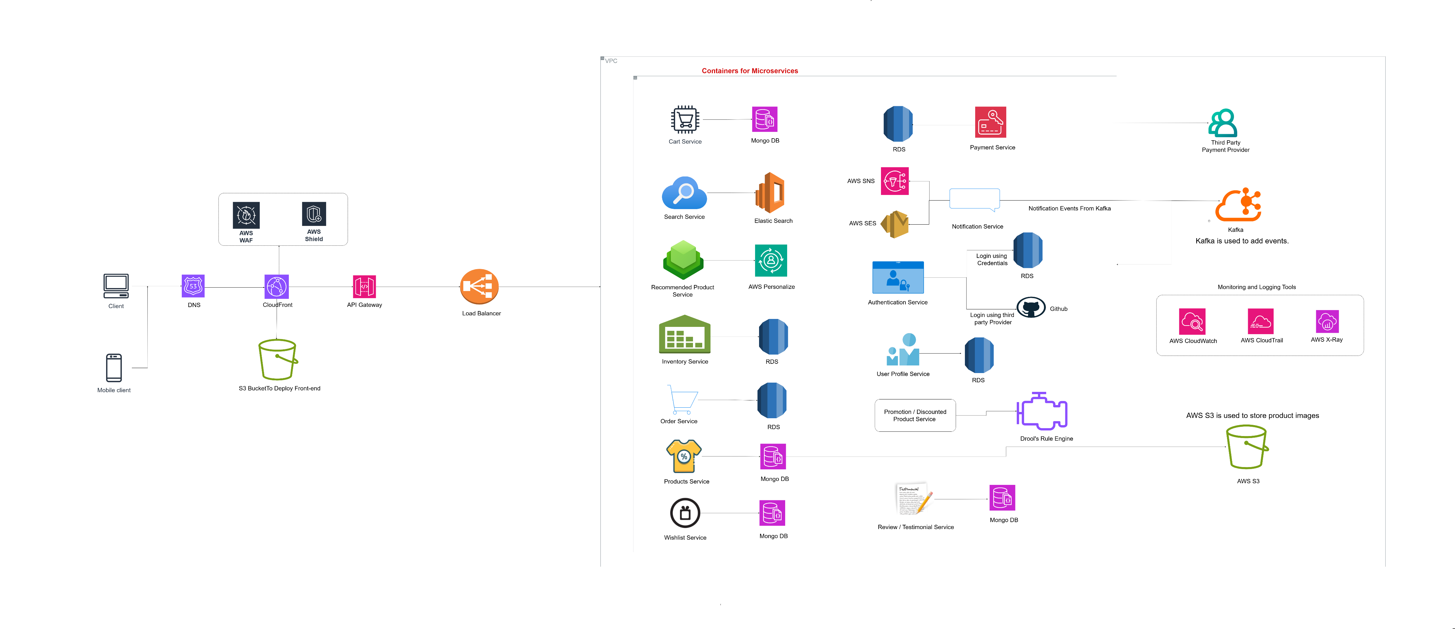
High Level Architecture Diagram

Slide 16
Technology Stack

Slide 17
Technology Stack
Frontend – React
Backend – Java, Spring Boot (Microservices)
Image storage – S3 Bucket
Events Queue – Kafka
Search Engine – Elastic Search
Databases – SQL and NO-SQL
Logging and Monitoring – AWS CloudTrail, AWS CloudWatch, AWS X-Ray
Notification - AWS SNS, AWS SES
CDN – AWS CloudFront

Slide 18
Deployment Diagram

Slide 19
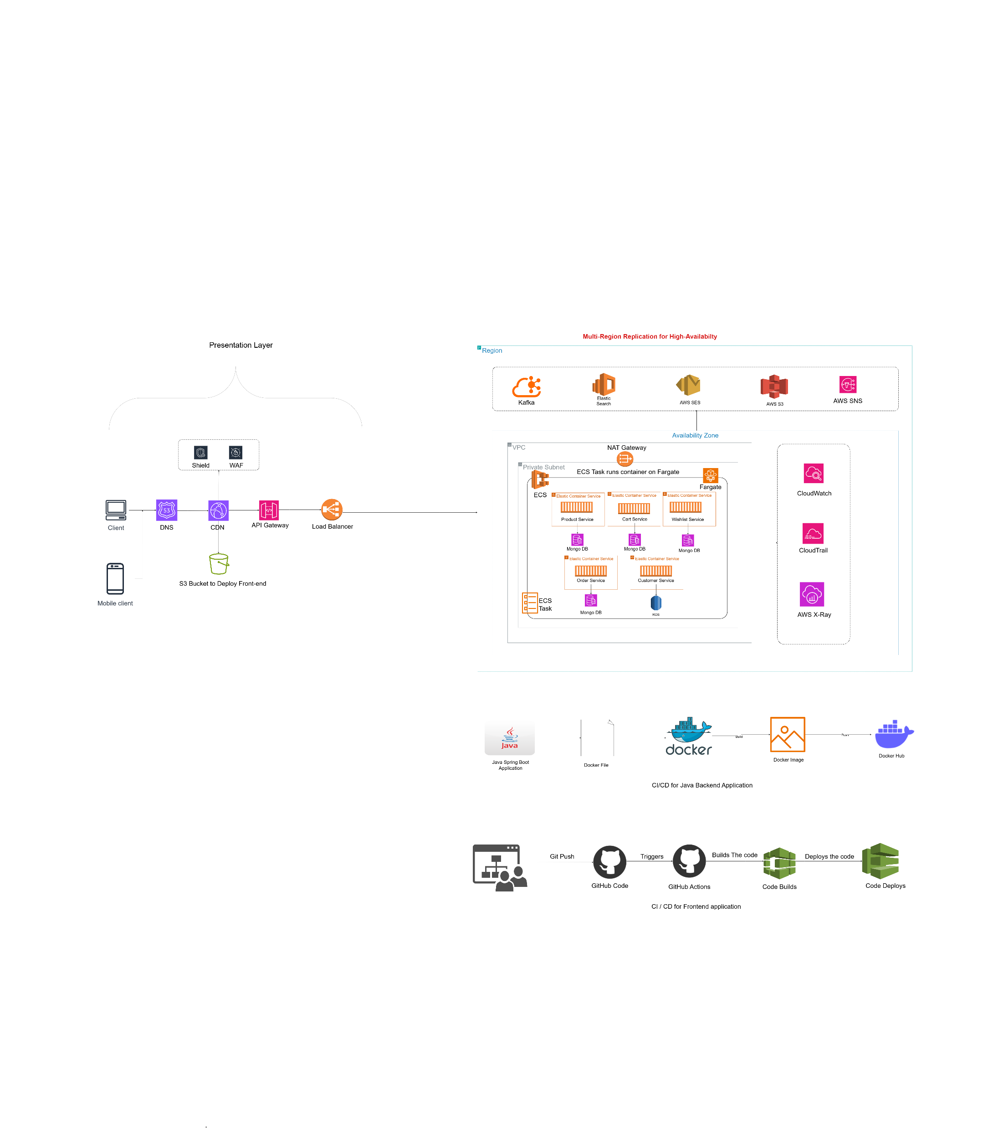
Deployment Diagram

Slide 20
Assumptions

Slide 21
Assumptions
Predefined Product Pricing
All products will have their base prices stored in the product database.
Dynamic Discount Calculation
When a user searches for a product or visits a promotional section, the Rule Engine will dynamically determine the applicable discount.
Real-Time Discounted Pricing
The Rule Engine generates a new field for the discounted price, which will be displayed on the UI in real-time.

Slide 22
Thank You

